Slide 1



Slide 2
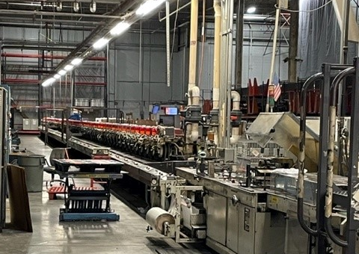
Disrupting the Transitional Newspaper Model
How to we disrupt the traditional newspaper model?
Tasked with building utilization to increase revenue opportunities
Explored several business plans
Digital printing operation offered most opportunity for TWP.
Notes:
Talk through the class at George Mason and challenge to find new ways to increase revenue through building utilization

Slide 3
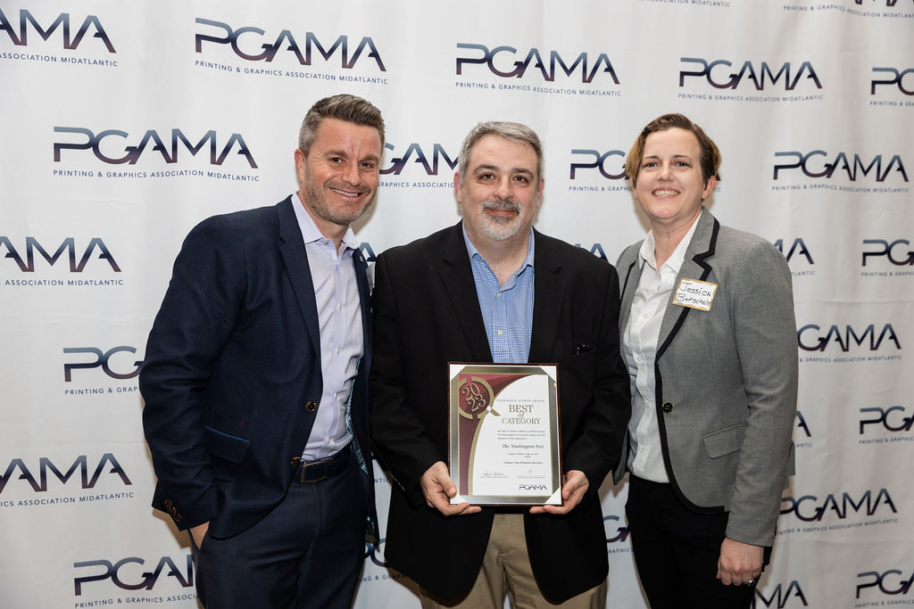
Commercial Printing on a Budget
Treat it like a startup
Utilized existing staffing
Begin with one shift, expand as the business grows
Leverage Internal & External partnerships
Notes:
Discuss process of selecting the commercial printing business model and how we would treat it like a startup with all the infrastructure benefits of TWP

Slide 4
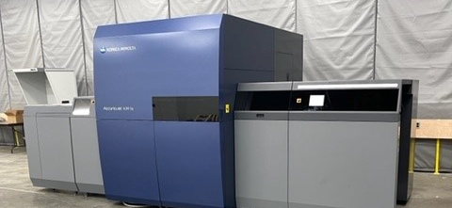
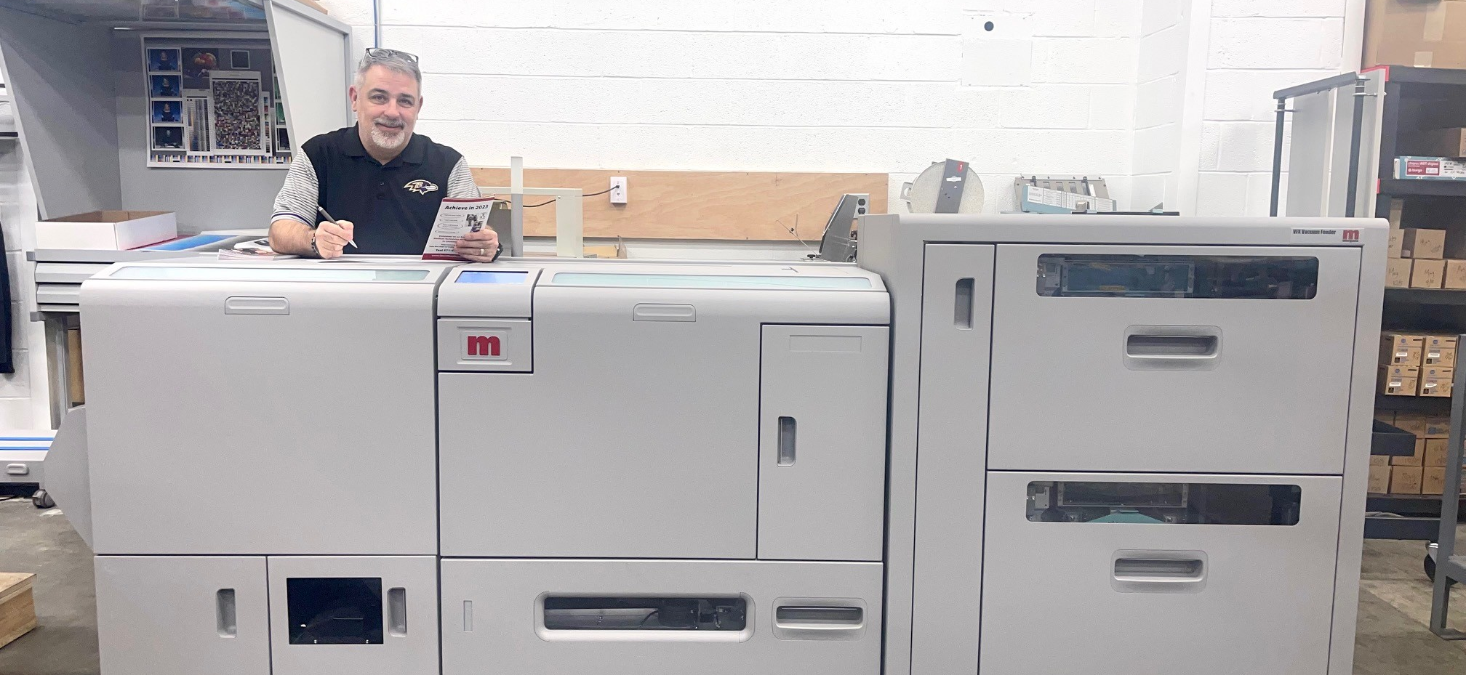
Equipment
Inkjet Press: KM1e (UV Inkjet)
Toner Press: KM 6100/14000 (toner)
Finishing: Polar cutter, Morgana BM5050,
MBO Folder
Notes:
Equipment selection. Chose the press with the understanding that we would need to grow the finishing capabilities.

Slide 5
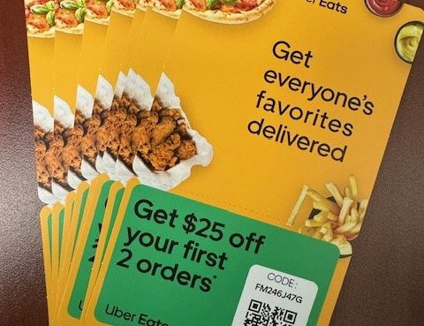
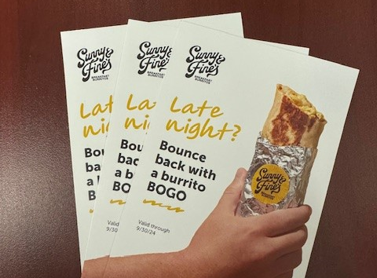
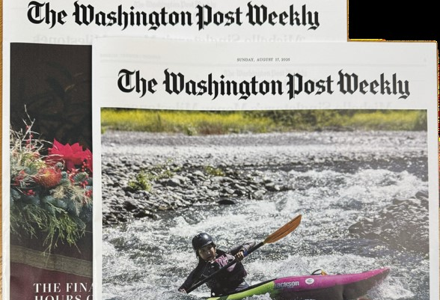
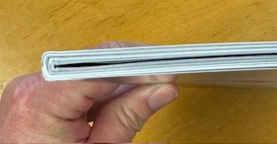

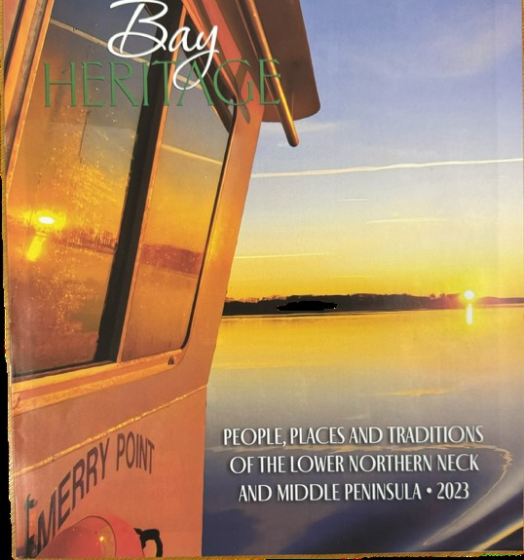
What We’ve Built
Built the business from scratch
Pulling in more work from existing legacy customers
Internal products
Notes:
Commercial Business, new TWP products and expanding partnership with existing legacy customers

Slide 6
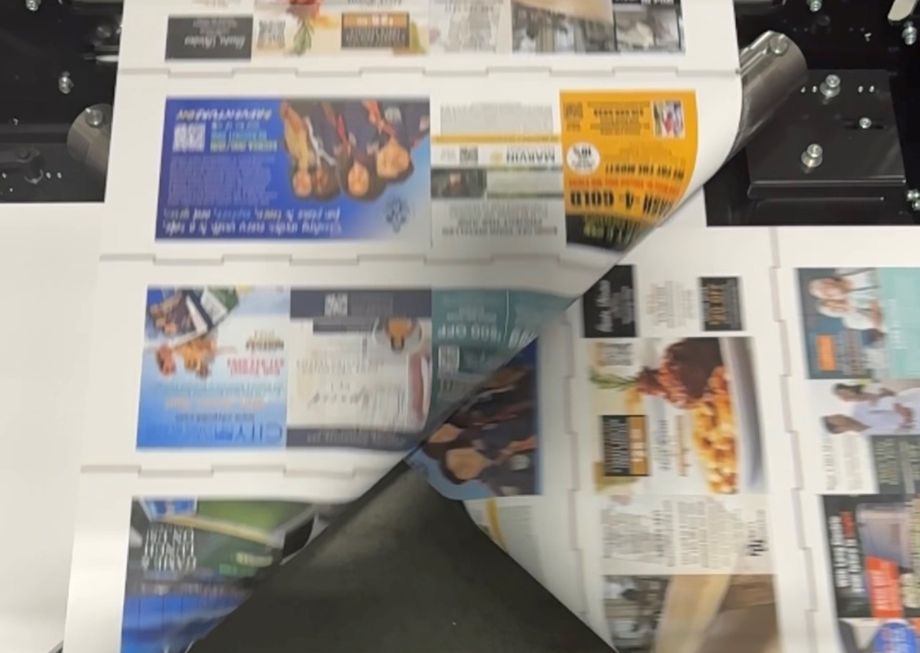
Building the Future
Inkjet Rollfed Press Roll to Roll
Finishing equipment Roll to Finish
Increase Volume
Build the future for TWP
Notes:
Whats next…exploring rollfed inkjet presses, Roll to Roll finishing

Slide 7

Conversation& Questions

