Slide 1


CherryRoad® Media
Digital Printing
September 25, 2025
Jeremy Gulban and Jeff Elmblad

Slide 2

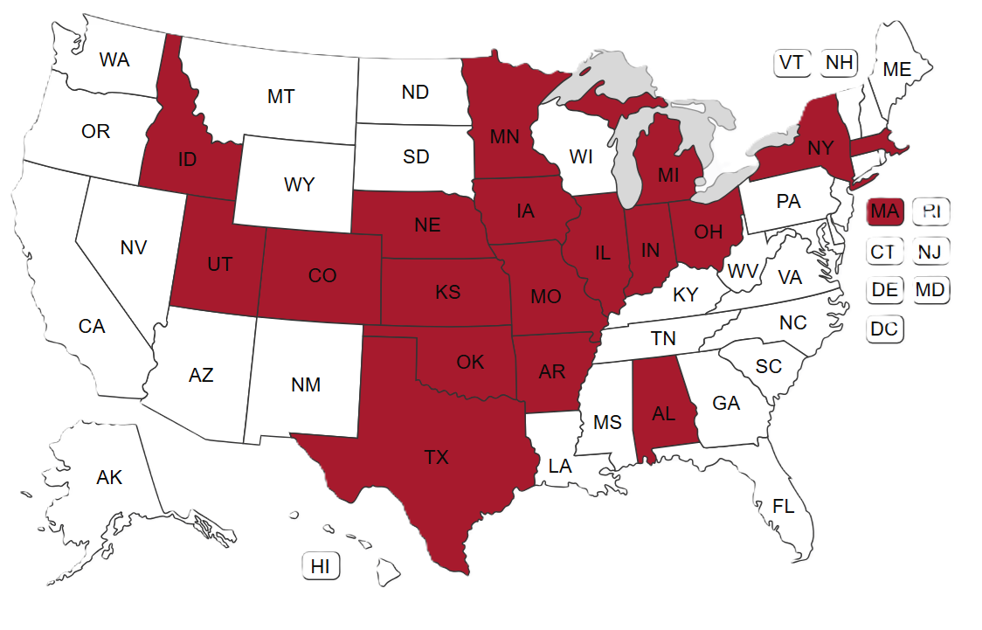
Our Growth Story
Now operating 97 local titles, primarily weeklies
Our markets are smaller than traditional investment targets (many under 800 subscribers)
3 web press sites – Hutchinson, Kansas; Delphos, Ohio; Slayton, Minnesota

Slide 3

2025 Challenges
Waste 1,000 copies to print 500 sellable copies
Finding skilled pressmen, especially in Slayton
Tariffs on consumables

Slide 4
Our Transition to Digital Printing

Slide 5
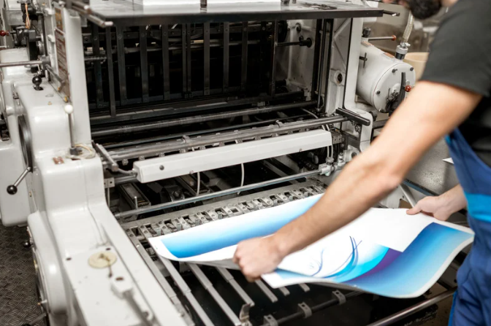
Digital Printing Plan
Partner with CDS, largest Xerox dealer in North America
Use high-capacity office printers to print short-run tabloid newspapers
Ideal Use Cases:
  Short runs of under 1,500 copies
  Book sizes of 20 pages or less
  Remote locations
*Minimal skilled labor needed
*Two machine models

Slide 6
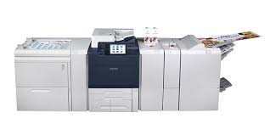
Xerox C9265
Throughput = 48 pages per minute
60-month lease Cost = $965 per month plus tax
Color Impression Cost = $.049 plus tax (two pages)
Black and White Impression Cost = $.009 plus tax (two pages)
15,000 Color Impression monthly minimum per machine
Staple Cost = $.011 plus tax per Book
Paper Cost = $.0269 plus tax per Sheet (four pages)
Labor Cost = Assumed at $20 per hour fully loaded
Assume 15 minutes per job for file preparation
Assumed maximum monthly capacity per machine = 125,000 pages

Slide 7
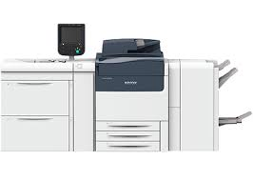
Xerox Versant 280
Throughput = 60 Pages per minute
60-month lease Cost = $1,650 per month plus tax
Color Impression Cost = $.049 plus tax (two pages)
Black and White Impression Cost = $.009 plus tax (two pages)
15,000 Color Impression monthly minimum per machine
Staple Cost = $.011 plus tax per Book
Paper Cost = $.0269 plus tax per Sheet (four pages)
Labor Cost = Assumed at $20 per hour fully loaded
Assume 15 minutes per job for file preparation
Assumed maximum monthly capacity per machine = 300,000 Pages

Slide 8

Fully Loaded Costs
12 Page Book with 4 B&W Pages = 58 Cents per copy
16 Page Book with 4 B&W Pages = 71 Cents per copy
20 Page Book with 10 B&W Pages = 68 Cents per copy

Slide 9
CherryRoad Use Cases

Slide 10

Use Case #1 - Arkansas
Six weeklies
Print runs rage from 200 - 750 copies
620 miles per week ($744) of incremental hauling eliminated
Installed two C9265 machines in two locations
Each machine handles three papers
Annual estimated savings = $57K

Slide 11

Use Case #2 – Independence, MO
Two 1500 run, five day-per-week papers; 21 weeklies
Four 460-mile hauls per week ($2,258) eliminated
Hybrid Model:
  Digital eight-page tabloids on Tuesday, Thursday, Friday
  Web press broadsheets on Wednesday & Saturday capture legals, preprints, comics
Three Versant 280 machines
Two staffers can run all three machines simultaneously
Estimated annual savings = $190K

Slide 12

Use Case #3 – Northern MN
Three weekly markets served by two print locations
Two C9265 in Cook (Centrally located- prints two markets)
One C9265 in Grand Marais (Remote, prints its paper only)
Printers are underutilized, especially Grand Marais
Estimated annual savings = $38K

Slide 13
Concluding Thoughts

Slide 14

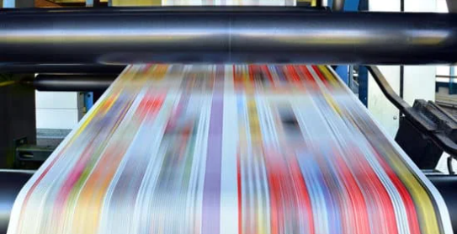
Reimagining Local News Printing
SMARTER PRINTING = STRONGER COMMUNITIES
Digital = lower costs, faster turnaround, more flexibility
Proven savings across multiple markets
Expanding possibilities for sustainable community journalism

Slide 15

Q&A
Reach Out: jgulban@cherryroad.com

Slide 16


Th﻿ank You
Let’s strengthen communities and drive progress - together.

