Slide 1
Automation and the effective use of AI
International Newspaper Group 2025

Slide 2
How do you integrate AI into a legacy workforce?
Start With Business Pain Points, Not AI
Don’t lead with “AI.” Lead with what hurts. For example:
  Manual data entry taking too long – Desktop Monitoring – API Integrations
  Customer service bottlenecks – Voice assistants, chatbots
  Inefficient forecasting or scheduling – Calendaring tools
  Frame AI as a tool to relieve friction rather than a shiny new toy. People respond better when the change is tied to problems they already complain about.
Show, Don’t Tell
Legacy workforces are often wary of buzzwords. Instead of decks about “machine learning models,” show a simple pilot:
  An AI tool that drafts reports but still requires human review – data applications
  A chatbot that handles routine HR questions – Herbie (Hearst integrated bot)
  Quick, visible wins build credibility faster than strategy papers.
Build Trust Through Augmentation, Not Replacement
The fear of “AI taking my job” is real. Combat it directly:
  Position AI as a copilot that reduces grunt work, not a substitute for expertise.
  Keep humans in the loop for final decision-making.
  Use language like “assist,” “accelerate,” and “support” rather than “automate away.”

Slide 3
How do you integrate AI into a legacy workforce?
Pick Champions, Not Just Executives
Change sticks when peers drive it, not just leaders. Identify “trusted veterans” who:
  Have credibility in the old guard.
  Are willing to experiment.
  Can showcase AI’s value to their peers.
  These champions bridge the trust gap far better than outsiders or consultants.
Integrate Into Workflows, Not On Top of Them
Don’t make people juggle another app. Integrate AI into the systems they already use:
  AI assistants built into email, ERP, or CRM.
  Automated insights delivered in Excel, not in some new dashboard no one checks.
  Voice-activated tools where typing is impractical.
  Meet them where they are.
Lead With Governance and Transparency
Legacy workers respect rules and structure. Provide clarity:
  What data is AI using?
  Who’s accountable if it’s wrong?
  What guardrails exist to prevent misuse?
  Clear policies and transparency reduce resistance.

Slide 4
RPA’s – Robotic Process Automation Tools
Pre-Press Operations
  Data Handling & Layout Automation: RPA can ingest data from multiple editorial systems, automatically feed it into layout/design templates, and ensure pagination rules are followed.
  Ad Placement & Verification: Automates insertion orders, checks ad sizes and positions against rules, and flags errors before print.
  Proofing: Bots can send automated proofs to clients and collect approvals, eliminating repetitive back-and-forth.
Press Operations
  Scheduling & Workflow Coordination: RPA can align press runs with demand forecasts, automatically generate production schedules, and adjust for last-minute changes.
  Inventory Management: Bots can track ink, paper, and plate stock levels, generate reorder requests, and optimize usage to reduce waste.
  Quality Control Integration: RPA can pull sensor and IoT data from presses, compare to tolerances, and alert staff to anomalies in real time.
Post-Press & Distribution
  Mailing & Labeling: Automates label generation, subscriber list management, and postal compliance checks.
  Routing & Logistics: Bots can integrate with routing software to optimize delivery schedules, track delivery performance and deploy automated messaging from daily transactions to escalated complaints.
  Returns Management: Automates credit issuance for unsold copies and integrates with circulation systems to refine print run forecasts.

Slide 5
RPA’s – Robotic Process Automation Tools – Con’t
Back-Office & Customer Service
  Billing & Accounts: Automates invoice generation for advertisers, reconciles supplier bills, and flags discrepancies.
  Regulatory Reporting: Ensures compliance with postal and circulation audits by pulling together and formatting required reports.
  Employee Scheduling & Payroll: Streamlines workforce management for press crews, drivers, and distribution staff.
  Automated Customer Service Functions: Transactional integrations, receipt generations, password resets.
Strategic Benefits
  Cost Savings: Cuts down on repetitive manual tasks, reducing labor costs and errors.
  Speed & Flexibility: Makes it easier to create, distribute and automate revolving tasks ad changes, or disruptions.
  Data-Driven Insights: Automates data collection across production and distribution, creating a feedback loop for continuous improvement.

Slide 6
Email – Inbound
Inbound Email (Receiving / Processing) - AI can streamline how organizations handle incoming messages:
Spam & Phishing Detection
  Machine learning models filter malicious or irrelevant emails far better than static rules. They analyze sender reputation, language patterns, and links in real time.
Intelligent Routing & Prioritization
  AI classifies messages by intent (e.g., customer support, sales, HR) and urgency. This ensures the right teams see the right messages without manual triage.
Summarization & Response Suggestions
  NLP models can summarize long threads or generate draft replies to speed up response times, especially in customer support.
Sentiment & Topic Analysis
  Useful in customer service—AI can flag frustrated customers or recurring themes for escalation.
Personalized Auto-Responses
  For common queries, AI can generate personalized responses that still feel human rather than generic templates.

Slide 7
Voice - Inbound
Call Routing and Triage - AI can handle first-touch interactions
  Using natural language processing (NLP) to understand customer intent (subscription, delivery issue, billing, advertising, editorial inquiry).
  Routing calls or chats to the right department without requiring a long IVR menu.
  Prioritizing urgent cases (missed delivery for today’s edition vs. a general subscription query).
Virtual Agents & Self-Service
  24/7 virtual assistants (voice bots or chatbots) can handle routine requests like:
    Pausing/resuming delivery
    Updating addresses
    Checking subscription status
    Processing payments securely
  This reduces the load on human agents, letting them focus on complex or sensitive issues.
Real-Time Agent Assistance
AI tools can “whisper” help to human agents by:
  Surfacing relevant knowledge base articles in real time.
  Suggesting responses to common queries.
  Detecting sentiment and advising tone adjustments if a caller is upset.
  Translating between languages on the fly for multilingual support.

Slide 8
Voice - Inbound
Quality Monitoring & Training
AI can automatically analyze 100% of call transcripts for compliance, tone, and resolution quality.
Identifies trends (e.g., repeated complaints about delivery in a specific zip code).
Provides coaching insights to agents—who may get real examples of effective responses.
Personalization & Upselling
Integrates with subscriber databases to personalize conversations:
  “I see you’ve been a subscriber for 10 years—thank you.
AI can recommend tailored offers based on subscriber history and engagement.
Operational Insights
Call volume forecasting with AI demand prediction (anticipating spikes around major news events, elections, or billing cycles).
Identifying recurring pain points (delivery delays, login issues) and feeding insights back to operations teams.

Slide 9
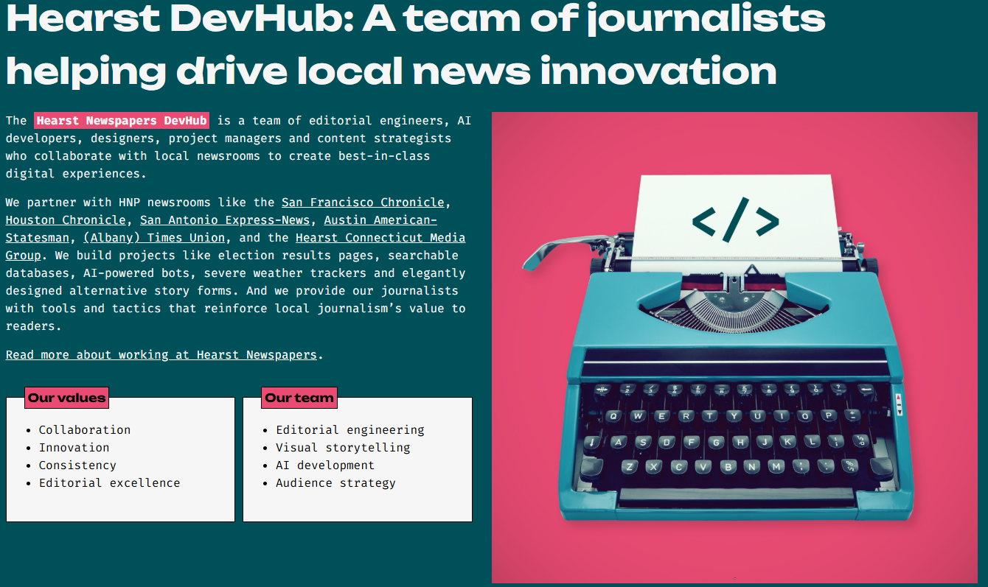
Hearst – DevHub

Slide 10
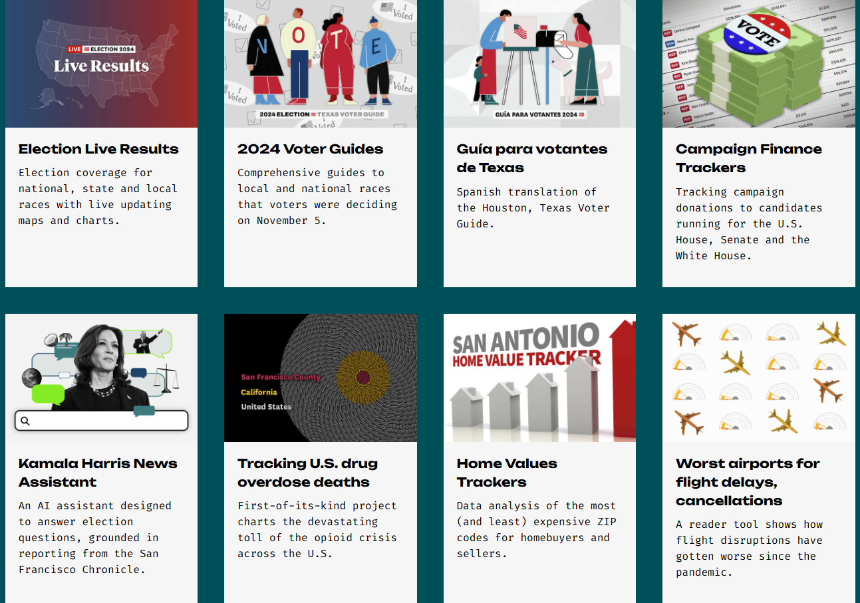
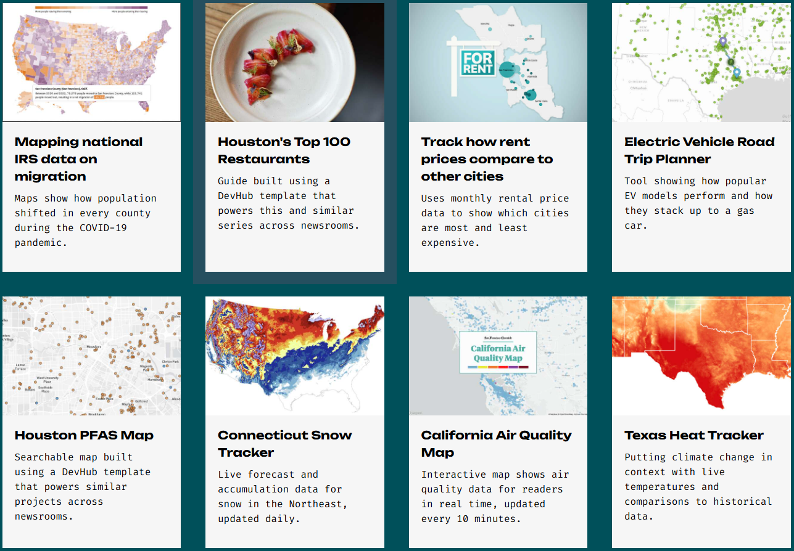
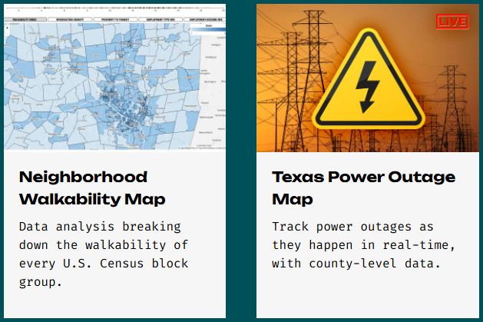
Hearst – DevHub Cont.
The DevHub and our HNP newsrooms publish dozens of interactive experiences, reader tools and data-driven articles every month.

Slide 11
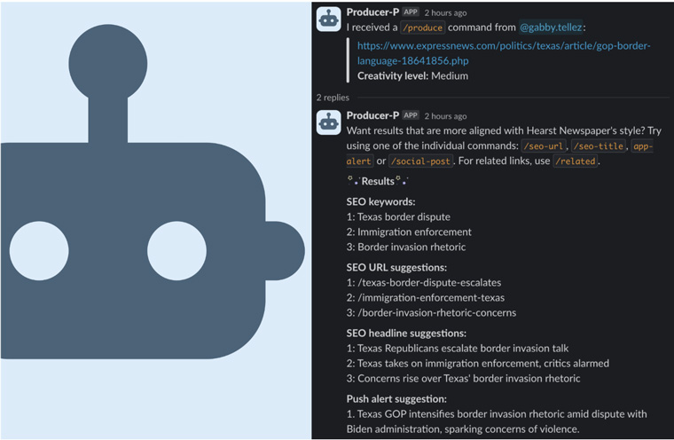
Digital Production - Producer P
How it started:
HNP’s DevHub — a team of journalist-developers and content strategists who collaborate with newsrooms to conceive, build, and publish interactive projects, news apps, internal tools, and storytelling templates — hired an AI automation engineer who had started building a smart and simple audience optimization tool, dubbed Producer-P, for one of our local newsrooms.
Producer-P leverages OpenAI’s GPT-4 and fine-tuned GPT-3.5-Turbo models to assist journalists in creating optimized headlines, SEO titles, URLs, related links, and notification summaries. By quickly analyzing article content, Producer-P not only cuts down the time needed for these tasks but also brings a variety of perspectives to content creation.
The system is designed with a focus on active user engagement. Rather than being directly embedded into HNP’s CMS, which could lead to an overreliance by editors on AI-generated content, it requires users to critically assess the content it generates in Slack and manually implement the bot’s suggestions.
Ethical and responsible AI usage is a cornerstone of Producer-P’s implementation. All users undergo a training program covering technical usage and broader issues relating to large language models. This training focuses on three essential rules:
  Maintaining human oversight.
  Limiting text generation to summarizing, aggregating or remixing reported, edited, and vetted information.
  Ensuring transparency with both readers and colleagues.

Slide 12
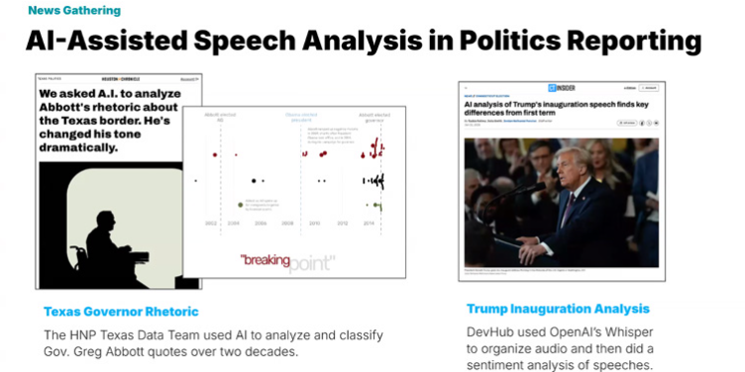
News Gathering - Assembly
News gathering. AI helps support core reporting functions with new tools.
Hearst’s Assembly tool, its most popular innovation, monitors public meetings by scraping video content and converting audio into transcripts using OpenAI’s Whisper.
These transcripts are timestamped and integrated into Hearst’s CMS, automatically alerting relevant reporters and editors, which allows for coverage of meetings that might otherwise go unnoticed.
This is particularly helpful on nights when two big meetings are happening at the same time and ensures reporters and editors will have information on both.
Document analysis. Another area where AI shines.
In Oakland, Hearst reporters used AI to sift through thousands of e-mails dropped during an election cycle, identifying patterns and constructing timelines that led to timely and impactful coverage.
Similarly, the Albany Times Union used AI to investigate “never events” in hospitals — cases where surgical tools were left inside patients — by analyzing years of complaint data.
Audio file analysis has also proven valuable. During severe flooding in Texas, Hearst combined AI with data reporting and on-the-ground journalism to build a timeline from hundreds of EMS calls. This provided readers with a clear, factual account of the disaster’s progression and supported deeper investigative work.

Slide 13
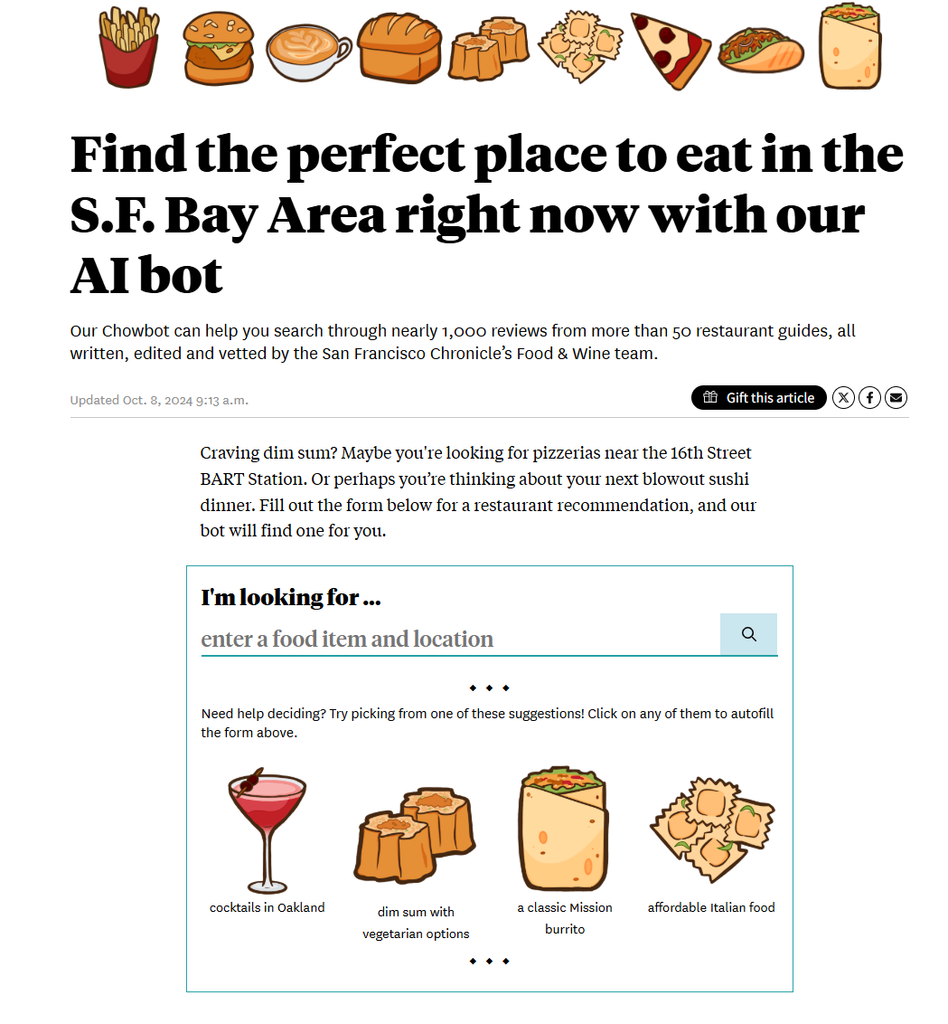
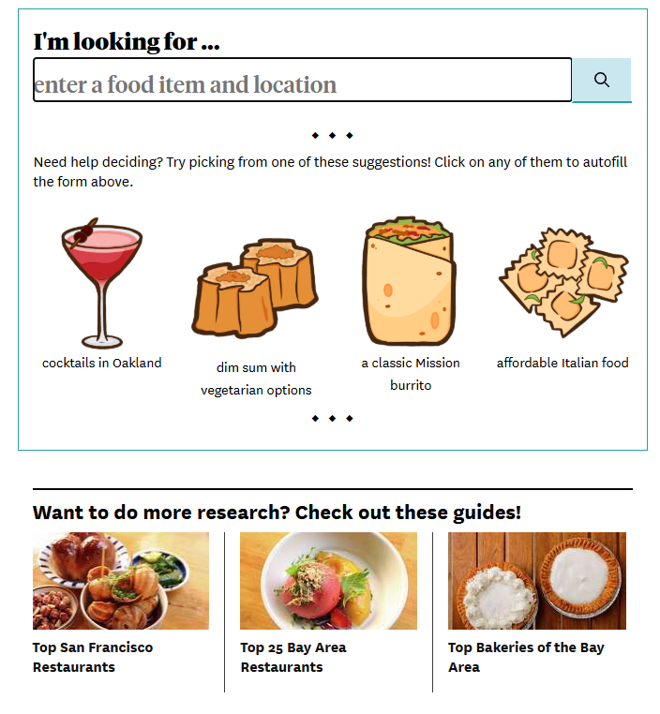
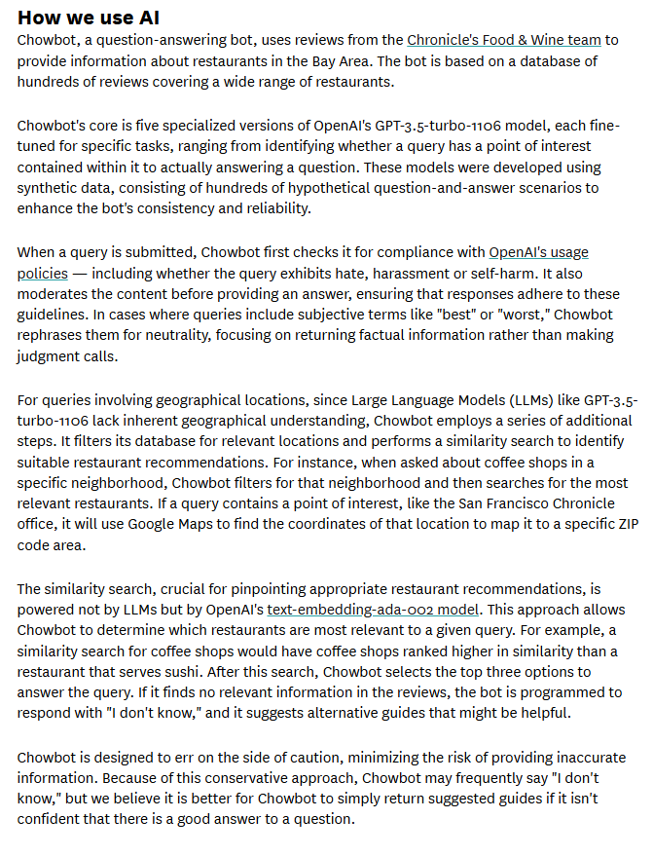
Reader Facing Experiences - Chowbot

Slide 14
QUESTIONS?

