Slide 1
Partnering with Logistics Providers: Overcoming Challenges and Celebrating Successes
Strategies to enhance collaboration and operational efficiency
Notes:
AI-generated content may be incorrect. --- This presentation explores the critical aspects of partnering with logistics providers, focusing on overcoming operational and financial challenges, ensuring safety and compliance, building a resilient culture, innovating driver retention, and optimizing fleet operations.

Slide 2

Key Areas of Focus
Rising Expenses in Logistics
How to combat rising costs
Innovative solutions
Notes:
--- We will cover five main areas: navigating operational and financial challenges, ensuring safety and regulatory compliance, developing a supportive company culture, innovating driver retention and service expansion, and optimizing fleet operations with strategic depot expansion. Image source: Microsoft 365 content library

Slide 3

Challenges in the driver labor force
Competition for Class A and B Drivers from large over the road carriers
Over night hours
You don’t just hop in the truck and drive
Notes:
--- A demonstrated focus on safety builds trust with customers and differentiates logistics providers in a competitive market. Image source: Microsoft 365 content library

Slide 4
How we meet the challenge
Make it feel more like family
Incentives for safety
Gift cards for birthdays
Funeral costs for direct family members
We have local work and they can sleep at home each night
Treat people right
Convert more to Non-CDL Trucks
Hiring process is fast and smooth as a family-owned business
Notes:
--- A demonstrated focus on safety builds trust with customers and differentiates logistics providers in a competitive market. Image source: Microsoft 365 content library

Slide 5
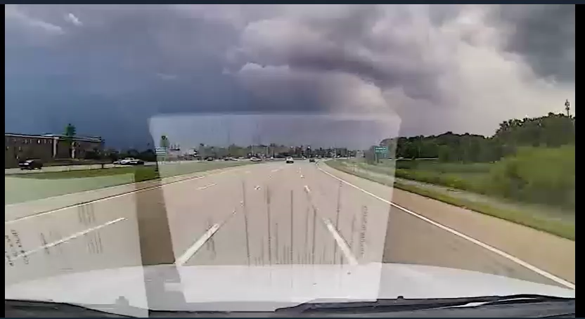
What drives up insurance. What we go through to mitigate against rising costs

Slide 6

Truck Lease and Maintenance costs
Parts Cost - Tires have gone from $400 to closer to $600 to $650 for a tractor
Labor Rates for Repair Shops - We’ve seen that rise from $90 to $150 over the last several years
Truck Ownership / Leases - 26’ Freightliner was $85K five years ago and is pushing $140K now
Towing – Any towing we do these days is running $2,000
Notes:
--- Multiple depots allow for better resource allocation, reduced travel times, and improved responsiveness to customer needs. Image source: Microsoft 365 content library

Slide 7
How we mitigate against those rising truck costs
Preventative Maintenance
Safety Cameras
Daily truck walk arounds
Safety training
Notes:
--- Multiple depots allow for better resource allocation, reduced travel times, and improved responsiveness to customer needs. Image source: Microsoft 365 content library

Slide 8

Innovative solutions
Paper Roll Hauling
Back hauling paper rolls from Sarasota to solve for storage issues in Lakeland and Gainesville
Flash hauls on short notice
Recent example of second truck from Canton to Detroit
Send extra trucks on bad press nights, making good decisions in the moment
Memphis and Jackson Airport for WSJ
Helping a partner save money
Automated Text Dispatch
Use technology so one call produces multiple e-mails
Notes:
--- The shortage of qualified drivers requires innovative recruitment strategies and incentives to attract and retain talent, maintaining smooth logistical operations. Image source: Microsoft 365 content library

Slide 9
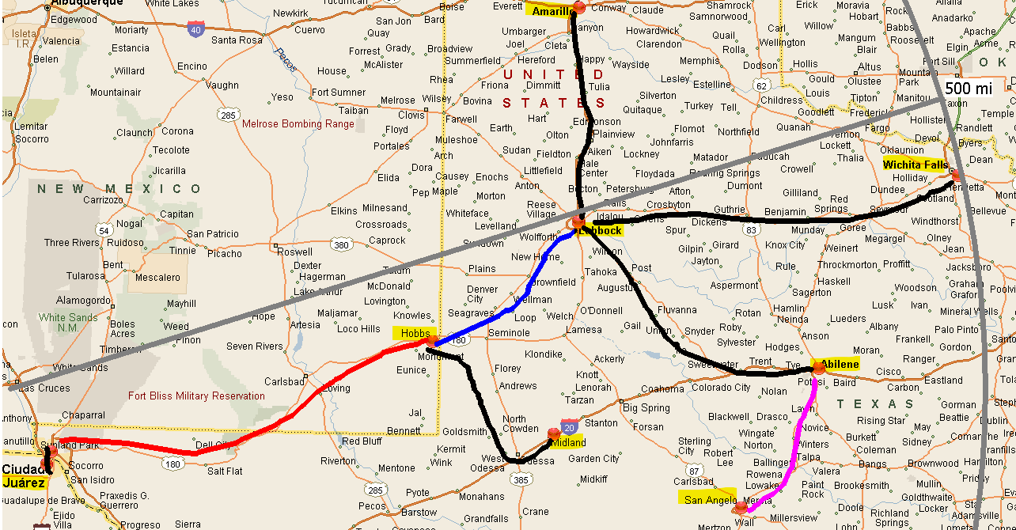
Creative long haul runs

