Slide 1
Route Optimization for Newspaper Distribution
Anthony Rapczynski
Sr. Director/Distribution
Houston Chronicle / HNP Support

Slide 2
Introduction & Context
Why route optimization matters to us.
Cost opportunities: Re-invest into the network.
Customer satisfaction: Improve carrier profitability to retain top performers.
Reduced carrier counts mean fewer contracts to manage and more time resolving customer issues.
Rising fuel costs and difficulty finding reliable contractors makes retention critical.

Slide 3
What is Route Optimization?
Definition - Route Optimization is the process of finding the best and most efficient route or sequence of routes for vehicles to travel when they need to visit multiple locations.
To reduce expense & improve carrier profitability to retain the best carriers.
Why is it needed?

Slide 4
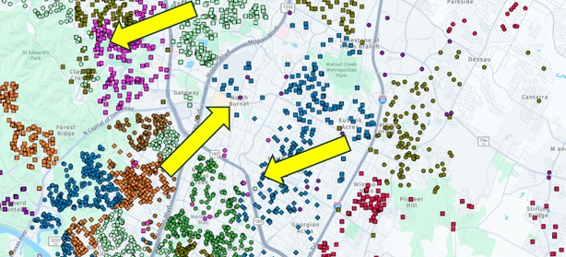
High Carrier Turnover?
Overlapping, inefficient routes creates expense and carrier turnover.

Slide 5
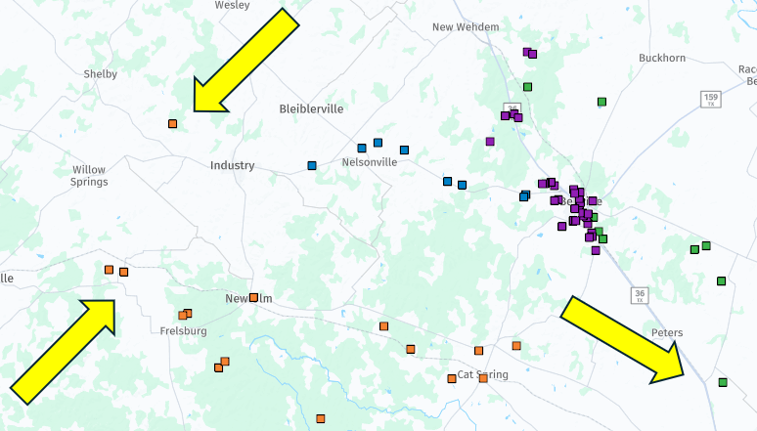
Miles Between Deliveries?
Driving miles between deliveries.
Determine what addresses are better delivered by the USPS.

Slide 6
Are routes picking up at the right DCs?
Selecting the most efficient starting points.
Right sizing distributor delivery areas.

Slide 7

Home Delivery Route Applications
Reduce carriers. Build segments.
Building evenly timed route segments allows field managers to sell route packages based on carriers’ needs and availability.

Slide 8
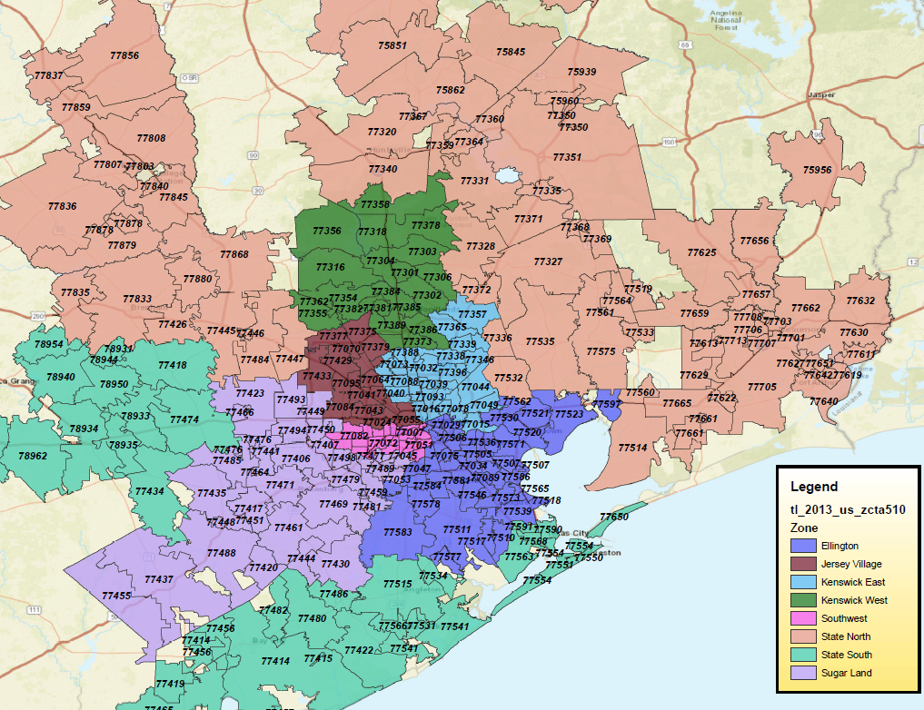
Zone Applications
Build efficient and effective advertising zones.
Building zones to match DC distribution or zip distribution.
Creates more efficient warehouse operations.

Slide 9

Delivery Area Applications
Right size unbalanced delivery areas
Are distributorships balanced properly to manage customer service and distributor profitability effectively?
Are distributors or districts crossing each other?
Is distributor turnover high due to low volumes and low profitability?

Slide 10
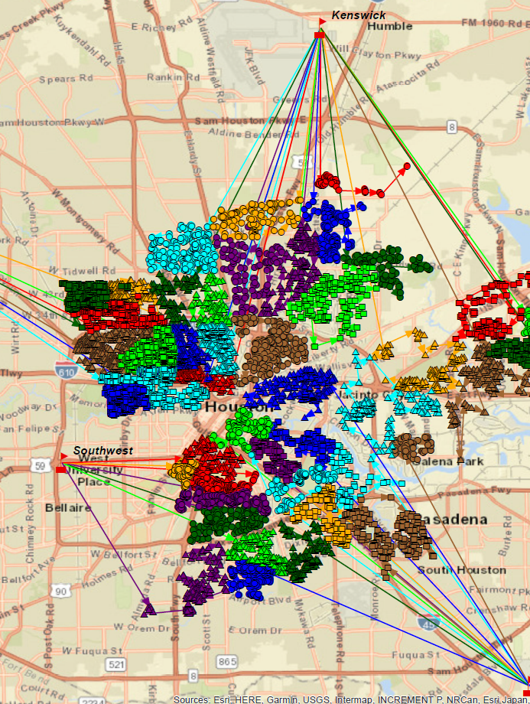
Route Starting Point Applications
Determine the most efficient starting point for routes.
Can miles and delivery times be reduced by having certain carriers pick up at different centers?

Slide 11
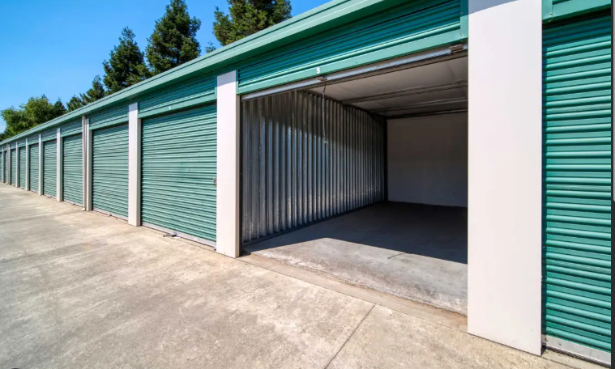
Warehouse Applications
10,000 SQ ft+ DC vs. several storage units?
Determining the optimal locations.
Balancing demand & routes between units.

Slide 12
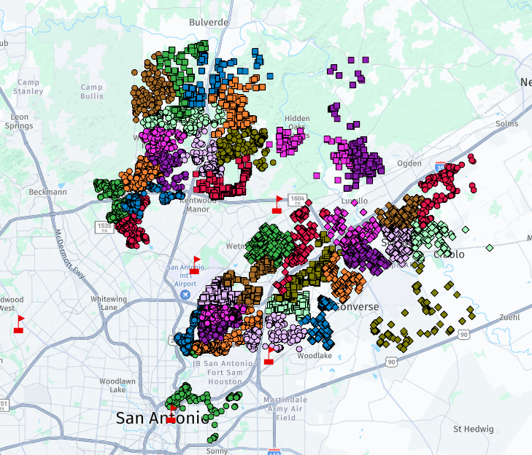
TMC Applications
Building routes & zones.
Building verification routes.

Slide 13
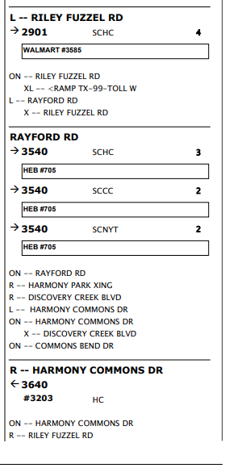
Single Copy Applications
Building routes.
Assigning deliveries to home delivery carriers.
Building collection routes.

Slide 14
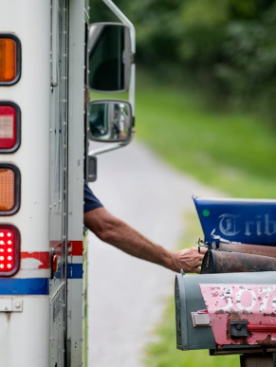
Mail Delivery Applications
Determine which addresses are more profitable to deliver by mail.
Load subscriber rates into attribute tables for easier analytics on potential revenue risks.

Slide 15
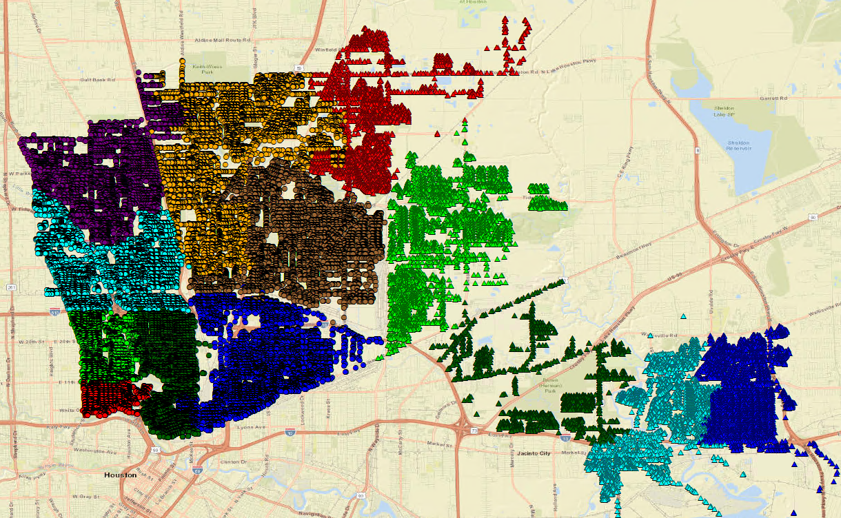
Router Applications
Assigning addresses to routes.
Building router segments.
Router cleansing.

Slide 16
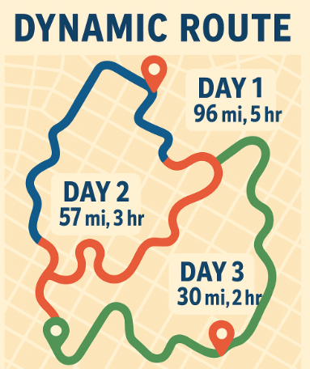
Last Mile Applications
The Last Mile is the most expensive part of the supply chain.
What opportunities exist to generate revenue & reduce cost to the consumer.
Magazines, other periodicals, etc.
Build dynamic routes & routers to accommodate swings in demand, time and miles.

Slide 17
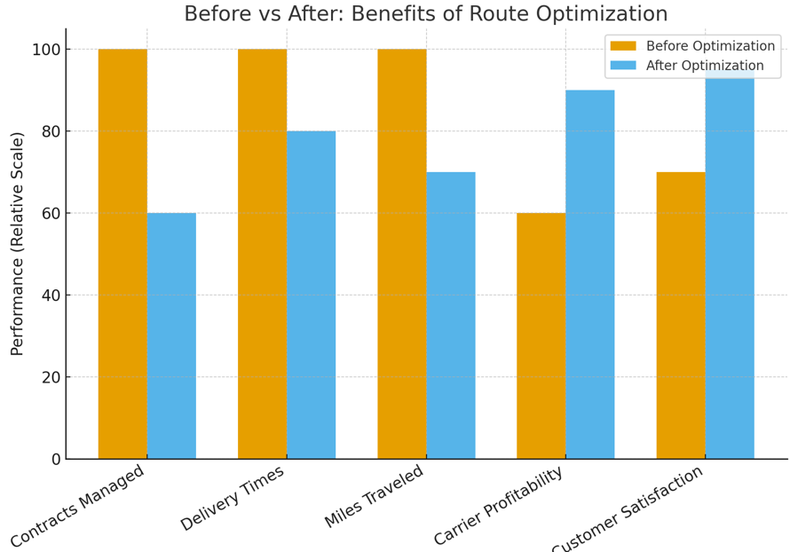
Benefits of Route Optimization
Fewer contracts to manage.
Improved delivery times.
Fewer miles traveled by carriers.
Increased carrier profitability.
Improved customer satisfaction.

Slide 18
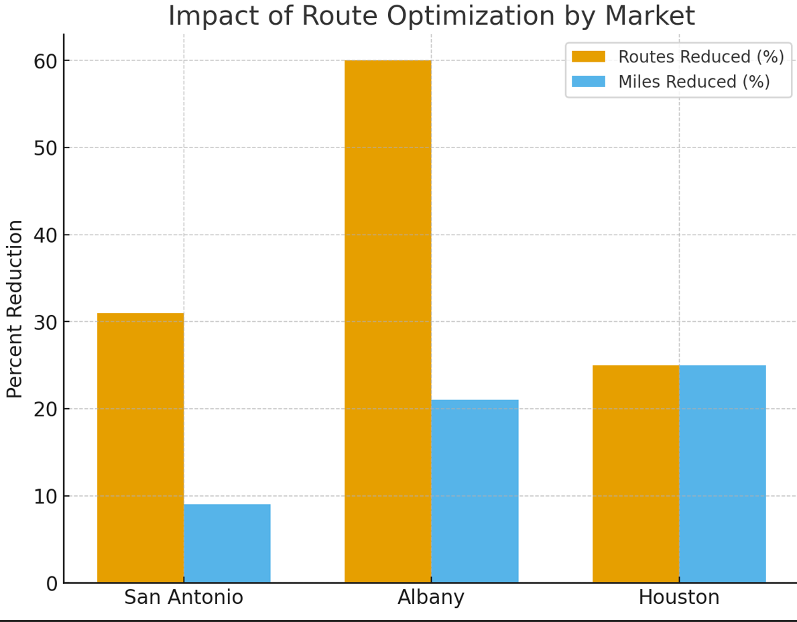
Examples
San Antonio – Reduced 17 routes or 31% and eliminated 181 miles/day or 9%.
Albany – Reduced 50 routes or 60% and eliminated 378 miles/day or 21%.
Houston – Reduced 25% of single copy collection routes.

Slide 19
Challenges & Barriers
🔄 Change management with legacy carriers
📍 Subscriber placement requests
🛣️ Carriers learning new routes
🤝 Distributor engagement & buy-in

Slide 20
Tools & Technologies
ArcGIS
RouteSmart
AI built Excel geo coding spreadsheet

Slide 21
Best Practices
Start with clean, accurate data.
Don’t optimize too much at once – ensure field can handle load.
Give field managers time to ride routes and adjust.
Give carriers time to learn new routes; incentivize if needed.

Slide 22
Best Practices
Communicate effectively: bi-weekly project meetings, distributor involvement. Make everyone feel like they are part of the entire process.
Ensure that optimization parameters work well for the geography, truck arrival times and carrier force being optimized. Including maximum volumes per route and time on route.

Slide 23
Looking Ahead
Future volume trends will demand the need for regular optimization.
Explore incorporating AI into the optimization process.
Continually evaluate new technology and techniques.

Slide 24
Conclusion
Ongoing route optimization must be regularly planned. It must be part of the DNA.
Invest in optimization.
Optimization isn’t a one-time project — it’s a continuous advantage.

Slide 25
Q&A

